Slide 1
Transfer Requests

Slide 2
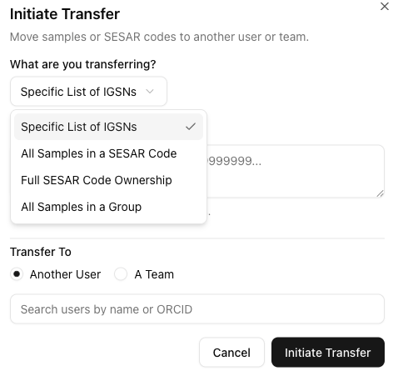
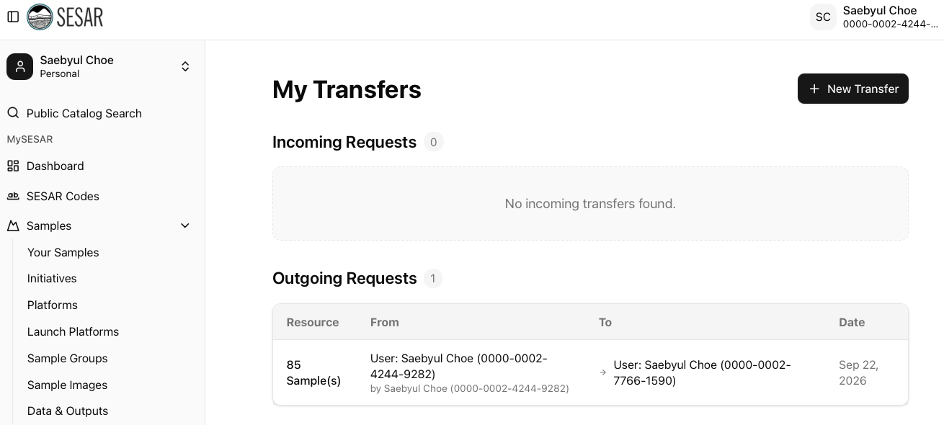
Transfer Request
Transfer samples and SESAR Codes between users and Teams by selecting specific lists of IGSNs to All Samples in a Group.
Select New Transfer to get started and follow the prompts.
Initiate Transfer when ready.

Slide 3
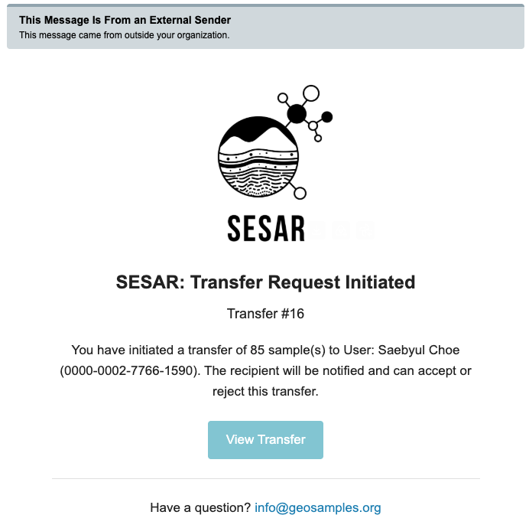
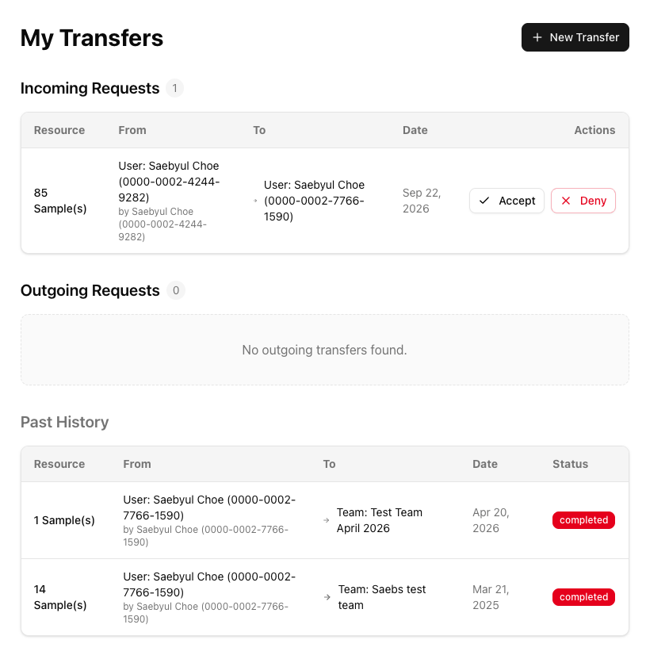
ACCEPT Samples or SESAR Code
Email notification will be sent to the transfer recipient.
Accept or Deny transfers. All transfer records and status are listed in Past History.

Slide 4
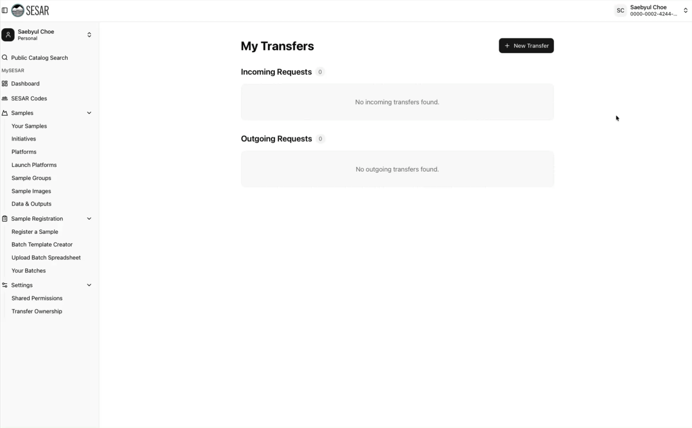
VIDEO Tutorial

